Slide 1
Welcome to my presentation
Computer fundamental and
Office application

Slide 2
Submitted by Mili Barai Roll: 01-031-19
Submitted TO:
MD: MAHBUB-E-NOOR
Trainee computer fundamental and office application

Slide 3
Salary sheet of Rahaman Company

Slide 4
2.Calculating some fenomenon of basice salary:
2.1.Minimum:
=MAX(D9:D18)
Result is 200000
2.2.Minimum:
=MIN(D9:D18)
Result is 15000
2.3. Average:
=Average(D9:D18)
Result is 73000

Slide 6
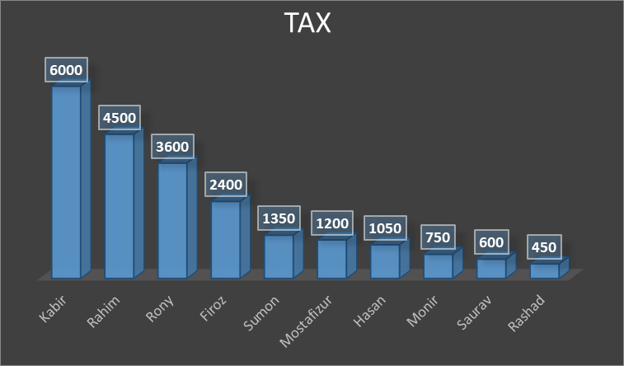
Graph chart from various members tax

Slide 7
Thank you

